Slide 1
SMART HOME BY UTSAV SHRIVASTAV

Slide 2
CONTENTS
INTRODUCTION
How does it work
Benefit Of Smart Home
Layout
Conclusion

Slide 3
INTRODUCTION
A smart home refers to a convenient home setup where appliances and devices can be automatically controlled remotely from anywhere with an internet connection using a mobile or other networked device. Devices in a smart home are interconnected through the internet, allowing the user to control functions such as security access to the home, temperature, lighting, and a home theater remotely.

Slide 4
How does it work
Anything in your home that uses electricity can be put on the home network and at your command.whether you give that command by remote ,computer or mobile
Smart homes work with with fairly simple systems.

Slide 5
Benefit Of Smart Home
Conveniently Protect Your Home and Belongings. ...
Keep an Eye on Your Kids, Pets, and Aging Parents. ...
Trim Your Energy Bills. ...
Answer the Door from Anywhere. ...
Make Your Home Awesome. ...
Save Money on Insurance.

Slide 6
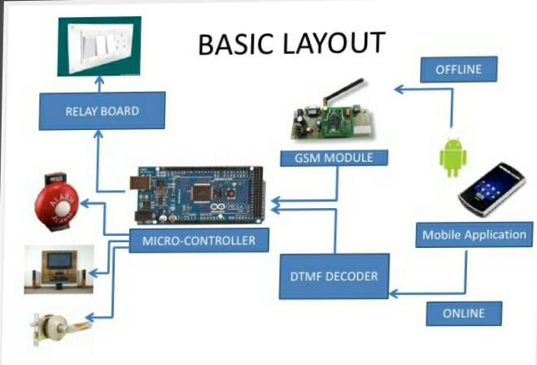
LAYOUT

Slide 7
Future work
a) There are a lot of other sensors that can be used to increase the security and control of the home like pressure sensor that can be put outside the home to detect that someone will enter the home.
b) Changing the way of the automated notifications by using the GSM module to make this system more professional.
c) A smart garage that can measure the length of the car and choose which block to put the car into it and it will navigate the car through the garage to make the parking easy for the homeowner in his garage.

Slide 8
Conclusion
In conclusion I can say that smart home are good but not the best.humans must to understand that if they don’t stop to develop more technologyes,our civilization will die because of radiation.

